Slide 1
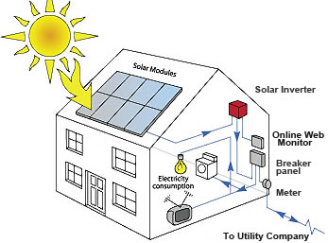
DEPARTMENT OF PHYSICS
SRM INSTITUTE OF SCIENCE AND TECHNOLOGY
18PYB103J – Physics: Semiconductor Physics
Module – III (Lecture S13 – SLO 1 & 2)
Photovoltaic Effect
Photovoltaic effect in PN Junction under illumination
18PYB103J Module 3 Lecture 1

Slide 2
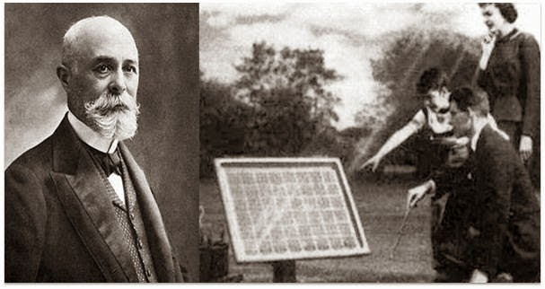
Photovoltaic effect: It is a process that generates voltage or electric current in semiconductor device when it is exposed to sunlight.
The photovoltaic effect was discovered in the year 1839 by French physicist, Edmond Becquerel. It find’s application in solar or photovoltaic cell to generate electricity.
18PYB103J Module 3 Lecture 1

Slide 3
History of Photovoltaic's
In 1839 – French physicist, Edmond Becquerel observed photovoltaic effect while experimenting with two silver-coated platinum electrodes immersed in a dilute acid and observed two electrodes altered their electric power under illumination.
In 1876 – William G. Adams and Richard E. Day who showed that electric power is directly produced under illumination.
In 1904 – Albert Einstein described the photoelectric effect on which photovoltaic technology is based.
18PYB103J Module 3 Lecture 1

Slide 4
1918 – A Polish scientist Jan Czochralski discovered a method for monocrystalline silicon production.
1941 – The first photovoltaic monocrystalline photovoltaic cell was constructed based on Czochralski method.
1951 – The first germanium photovoltaic cells was made in Bell’s Laboratories with 4.5% efficiency.
1957 – Hoffman Electronics introduced photovoltaic cell with 8% efficiency and a year later, the efficiency of increased to 9% .
18PYB103J Module 3 Lecture 1

Slide 5
Introduction to solar radiation
Solar radiation is a radiant energy emitted by the sun as a result of its nuclear fusion reactions.
Over 99% of the energy flux from the sun is in the spectral region of 0.15 – 4μm, with approximately 50% in the visible light region of 0.4 – 0.7μm.
Sunlight is composed of photons and the photons contain different amounts of energy that correspond to the different wavelengths.
18PYB103J Module 3 Lecture 1

Slide 6
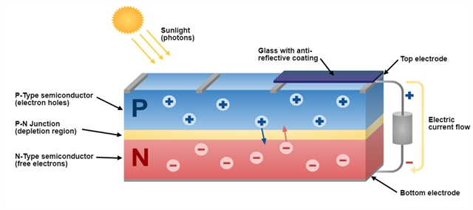
Photovoltaic in Semiconductor
The Solar or Photovoltaic cells are composed of two different types of semiconductor (a P-type and an N-type) that are joined together to create a PN Junction.
18PYB103J Module 3 Lecture 1

Slide 7
When photons strike a photovoltaic cell made by semiconductor PN junction, they may be reflected, absorbed or transmitted.
If photons are absorbed by the semiconductor then result is generation of electron-hole pair across PN Junction.
This electron-hole pair when separated from each other across the PN junction , results generation of voltage across the junction.
This voltage can drive a current in an external circuit called photocurrent
18PYB103J Module 3 Lecture 1

Slide 8
Photovoltaic in PN Junction under Illumination
When there is no light falling on the PN Junction, no electron-hole pair is generated. But when light is illuminated, it absorbs solar radiation and electron-hole pairs are generated.
Under the uniform illumination condition, generation of carrier will occur in the space-charge region as well as quasi-neutral region.
The carrier that are generated in the space charge region will be immediately swept away due to the electric field (electron towards N-region and holes towards P-region).
18PYB103J Module 3 Lecture 1

Slide 9
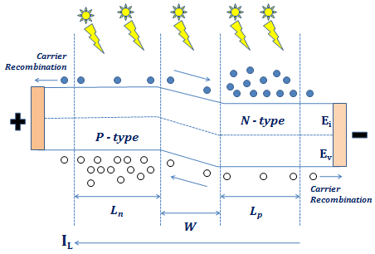
L_{n} and L_{p} - Diffusion length of electron and hole in Quasi neutral region, W – Width of depletion region or Space charge region, E_{v} – Energy of valence band and E_{i} – Fermi energy
18PYB103J Module 3 Lecture 1

Slide 10
Due to the electric field, chances of recombination of these electron pairs are quite less
The electron-hole pairs which are generated in the quasi neutral region will move around in a random manner.
In their random motion, some of the generated minority carriers will come near to the space charge region edge, where they will experience a force due to electric field and will be pulled at the other side
Only the minority charge carriers will cross the junction
18PYB103J Module 3 Lecture 1

Slide 11
Minority electrons from P-side will come to N-side leaving behind their positive charge called hole.
Similarly minority hole from N-side moves to P-side leaving behind their negative charge called electrons.
The drift of charge carriers creates a net increase in the positive charges at P-side and a net increase in negative charges at N-side.
This buildup of a positive and negative charge causes a potential difference to appear across the PN Junction under illumination. The potential difference created across light illuminated PN junction is called photo voltage.
18PYB103J Module 3 Lecture 1

Slide 12
The contribution to the photo voltage is coming only from the carriers that are generated within the semiconductor width (L_{n} + W + L_{p})
Light generated Current
In a semiconductor PN Junction, four current components are present in equilibrium condition: drift current due to electron and hole, diffusion current due to electron and hole
In equilibrium condition, net current is zero which requires the drift and diffusion currents of carriers to be equal and opposite.
18PYB103J Module 3 Lecture 1

Slide 13
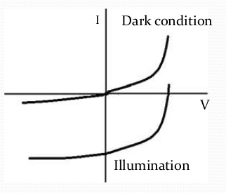
When semiconductor PN Junction is illuminated, there is large drift current is observed due to minority electron and holes carrier.
Therefore in the I-V curve under dark, I α V is observed as normally like PN diode.
But on illuminating the PN junction, large negative current caused by the light known as light generated current I_{L} is observed
Dark I-V curve and I-V curve under illuminated P-N Junction
18PYB103J Module 3 Lecture 1

Slide 14
The large negative current in illuminated PN junction is due to voltage which is generated due to light biases the PN Junction in a forward bias mode, the diffusion current flows opposite to the direction of light generated current
The light generated current is given by the following equation
I_{total} = I₀ (e ^{qV / kT} – 1) - I_{L}
18PYB103J Module 3 Lecture 1

